Slide 1
FINAL PROJECT TEMPLATE

Slide 2
THREAT SUMMARY
Summary of Situation: (Summarize the current threat situation)
There is a threat where cybercriminals are holding hostage of personal files and folders are encrypted. The only way to unlock the encrypted files is to pay the cybercriminals bitcoin. They are holding the files hostage until they are paid. In exchange, if the cybercriminals receive bitcoin they will unlock the personal files.
Healthcare organizations have fallen victim to cyber attacks after a new regulation have passed.
Hospital X noticed a ransomware attack in its environment.
Files of the Hospital have been encrypted in ransomeware.
The log servers cannot be analyzed to determine the details of the attacks and the attackers.
Some Doctors cannot provide treatment to their patients because they cannot view detailed information about patient status.
It is a critical situation because the negative impact can potentially force the hospital to shut down.
Asset: (What assets are being targeted?)
The personal files and folders are the assets being targeted.
Log Management Resources
Patient systems
Log systems are being targeted, and control systems used to monitor patients are being impacted.
Impact: (What part of the CIA triad is being impacted?)
I would say the part of CIA triad impacted is Availability because if they are holding the personal files hostage, so the files will not be available to access.
Threat Actor: (Identify potential threat actors)
The first threat actor is Cybercriminal. They are an external threat and they are performing ransomware because they are financially motivated and carry attacks for monetary reasons.
The second threat actor is an oblivious insider meaning that an employee within the company made a mistake of opening an email attachment then clicked on a link that had a phishing attack. The employee that open the email attachment was an Internal threat and he or she probably made a mistake without knowing it.
The third actor is potential hacktivists and/or FIN4 .
Threat Actor Motivation: (Share potential motivations behind the attacks)
The threat actor motivation was for monetary reasons. Cybercriminals want to attack to steal financial resources like money or bitcoin.
Attackers are seeking to retailiate against healthcare organizations that support new legislation.
Common Threat Actor Techniques: (Share attack methods commonly used by the threat actor)
The Threat Actor techniques are 1) Ransomware because the cybercriminal is holding the files hostage.
2)Phishing because the cybercriminal is sending email to an employee to trick the employee to opening the file.

Slide 3
Threat Profile :
Goals and Intent: Fraud, theft of financial resources like money or bitcoin.
Consequences: Financial impact of loss, reputation impact and more
Target: Hospitals and patients in the hospital
Capabilities: holding files hostage through form of ransomware
Tactics: Phishing Attack and Ransomware. Targeting employee within a hospital and trying to trick them to open fake link .
Time frame: Undetermined.

Slide 4
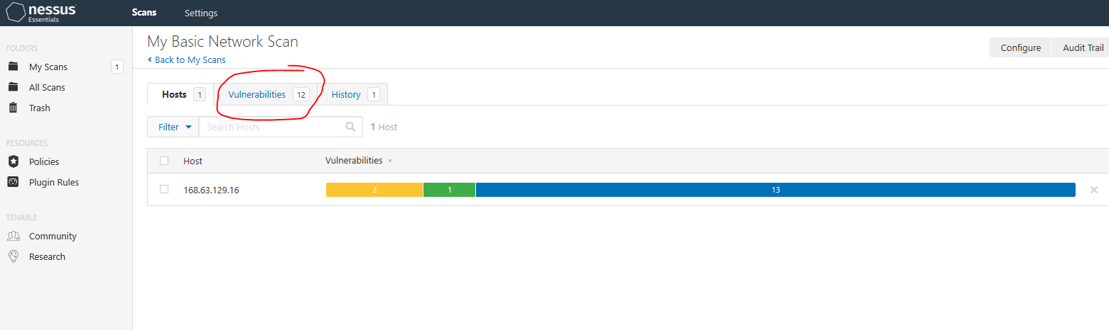
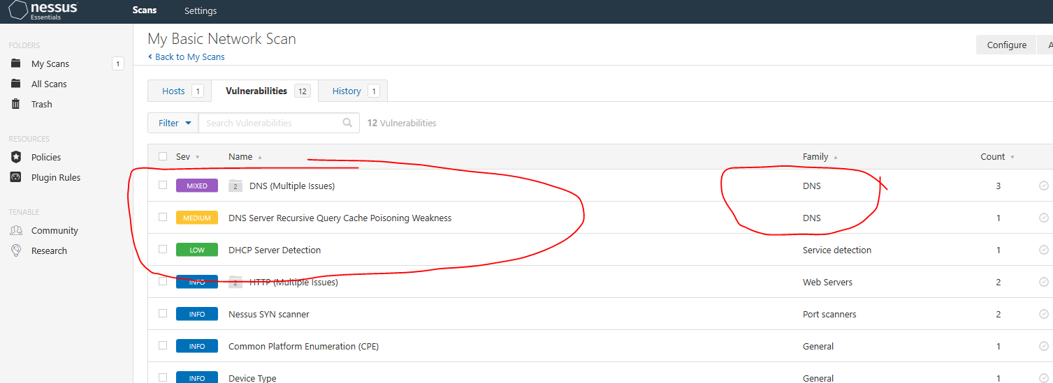
VULNERABILITY SCANNING TARGETS
Summary of scan targets:
Number of devices scanned: 12
Device type: DNS
Primary purpose of device: (describe what the devices are used for and what kind of data might be on them)
The DNS is the process of naming of IP Addresses. The DNS is known as Domain Name System, and it is used for naming system for Internet Addresses. It converts IP address with numbers in it into easy to read web address. The Data on it is IP address. It translates an IP Address into a website address.
(insert 2 screenshots from scan configuration window – one of the settings tab and one of the plugins tab)

Slide 5
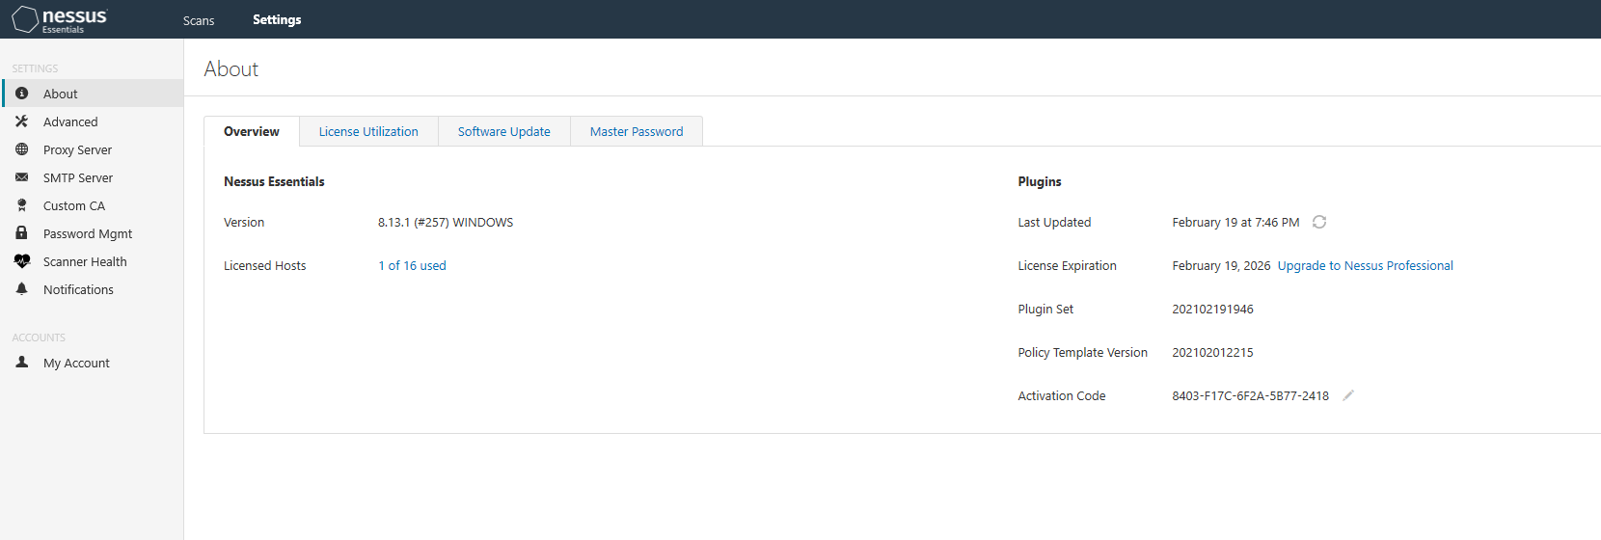
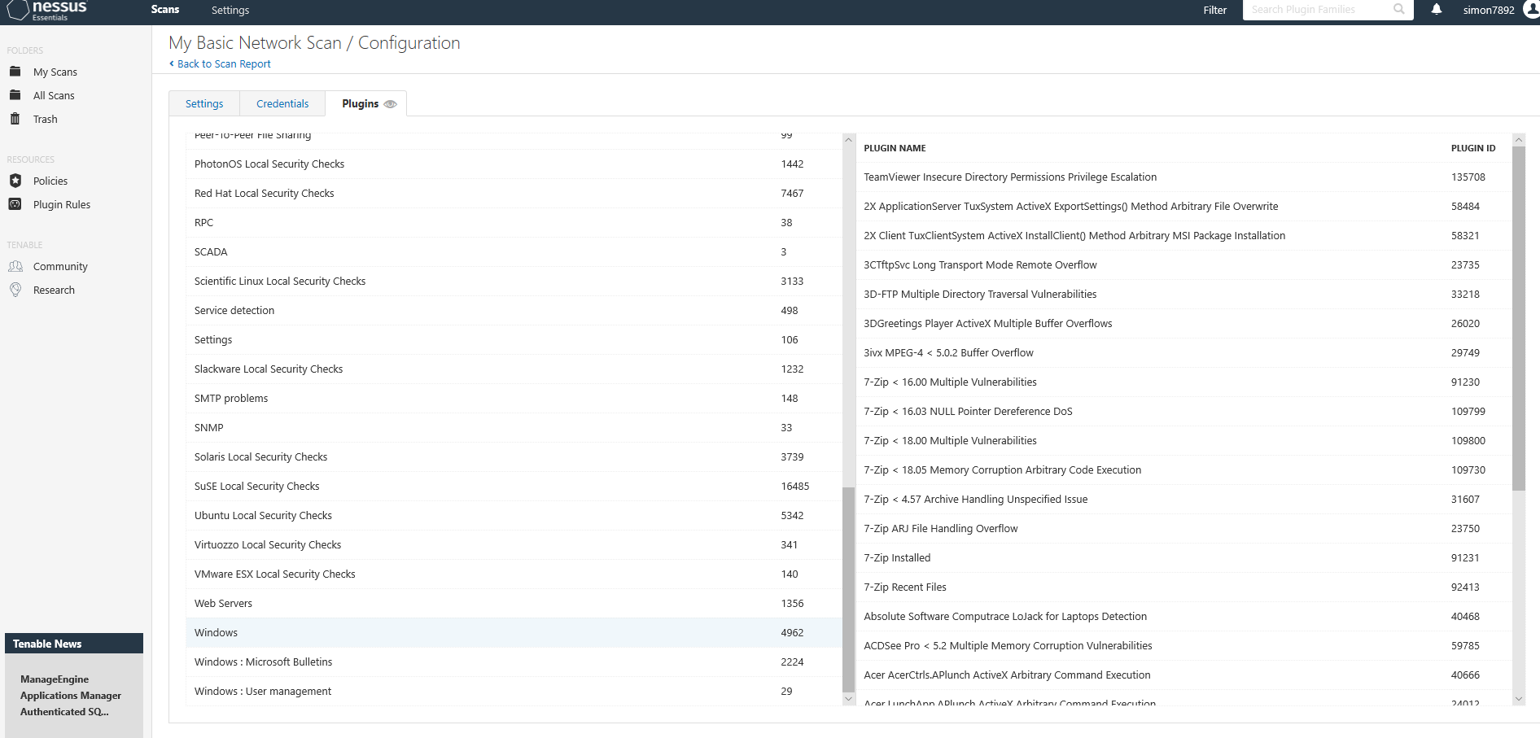

Slide 6
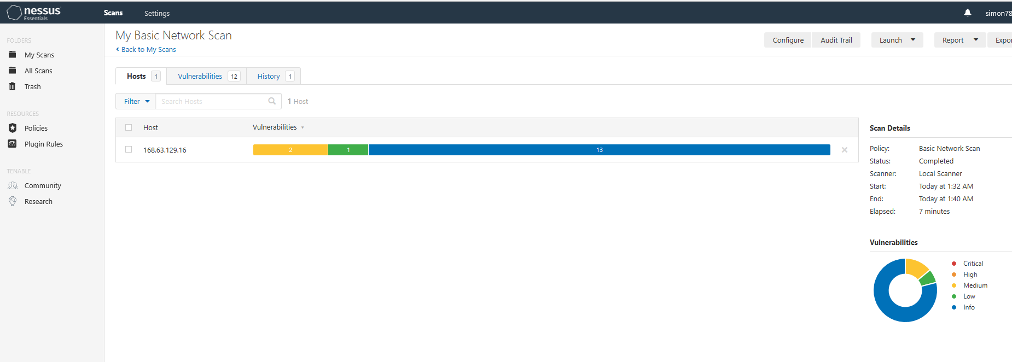
VULNERABILITY SCAN RESULTS
Summary of findings:
Total number of actionable findings:
Critical: 0
High: 0
Medium: 2
Low: 1
(insert screenshot from scan results dashboard)

Slide 7
REMEDIATION RECOMMENDATION
Fix within 7 days
Finding | Severity Rating | Recommended Fix
Fix within 30 days
Finding | Severity Rating | Recommended Fix
1) CVE-2006-0987 | Medium | Restrict access to DNS server from public network
2)CVE-1999-0024 | Medium | Restrict recursive queries to the host that should use this name server
Fix within 60 days
Finding | Severity Rating | Recommended Fix
CVSS2 #AV:A/AC | Low | Apply filtering to keep info out of network. And remove any options that are not in use.

Slide 8
PASSWORD PENETRATION TEST OUTCOME
Methodology: (Summarize steps taken to test password security)
My first step go to hashcat.net, then I downloaded the hashcat binaries 5.1.0. Next step, once I downloaded it I store the folder in documents.
Then I created some folders like: wordlists. I created some text files like: hashes.txt and rockyou.txt. Look on powerpoint slide 9 for more info.
My next step is to go to command prompt then enter: cd downloads\hashcat-5.1.0 .I shown my screenshot of my steps taken on the next powerpoint slide.
Number of passwords tested: ( 4)
Number of passwords cracked: ( 4)
Evidence of weak passwords: Common passwords, short passwords, words that are easy to guess.
(insert screenshot of cracked passwords and command used to launch attack)
On the next page is my screenshot.
Recommended steps to improve passwords security: (Summarize best practice recommendations to avoid brute force attacks in the future)
Avoid easy to guess password and short passwords. Don’t use common dictionary words. Try to use long passwords or at least 12 character passwords.
Use a mix of letters(Upper and Lower case), numbers, and special characters.

Slide 9
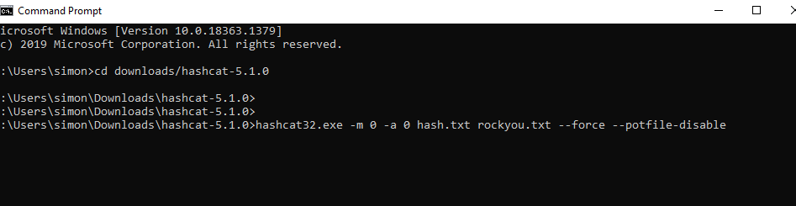
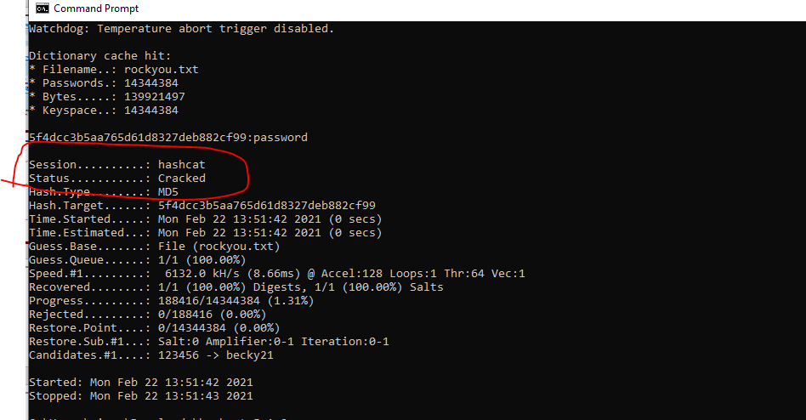

Slide 10
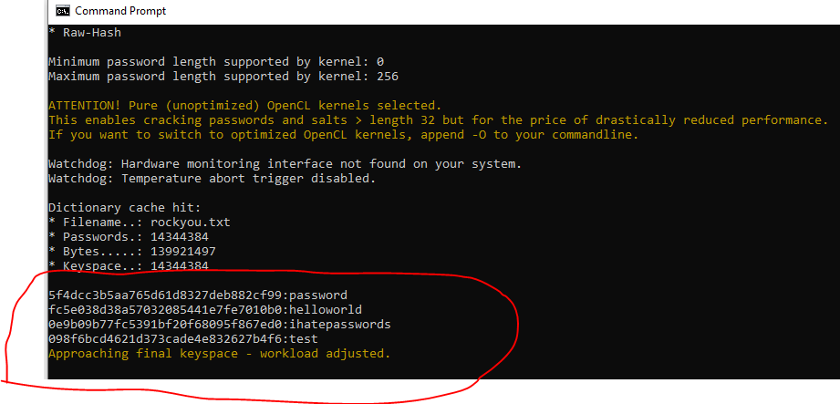

Slide 11
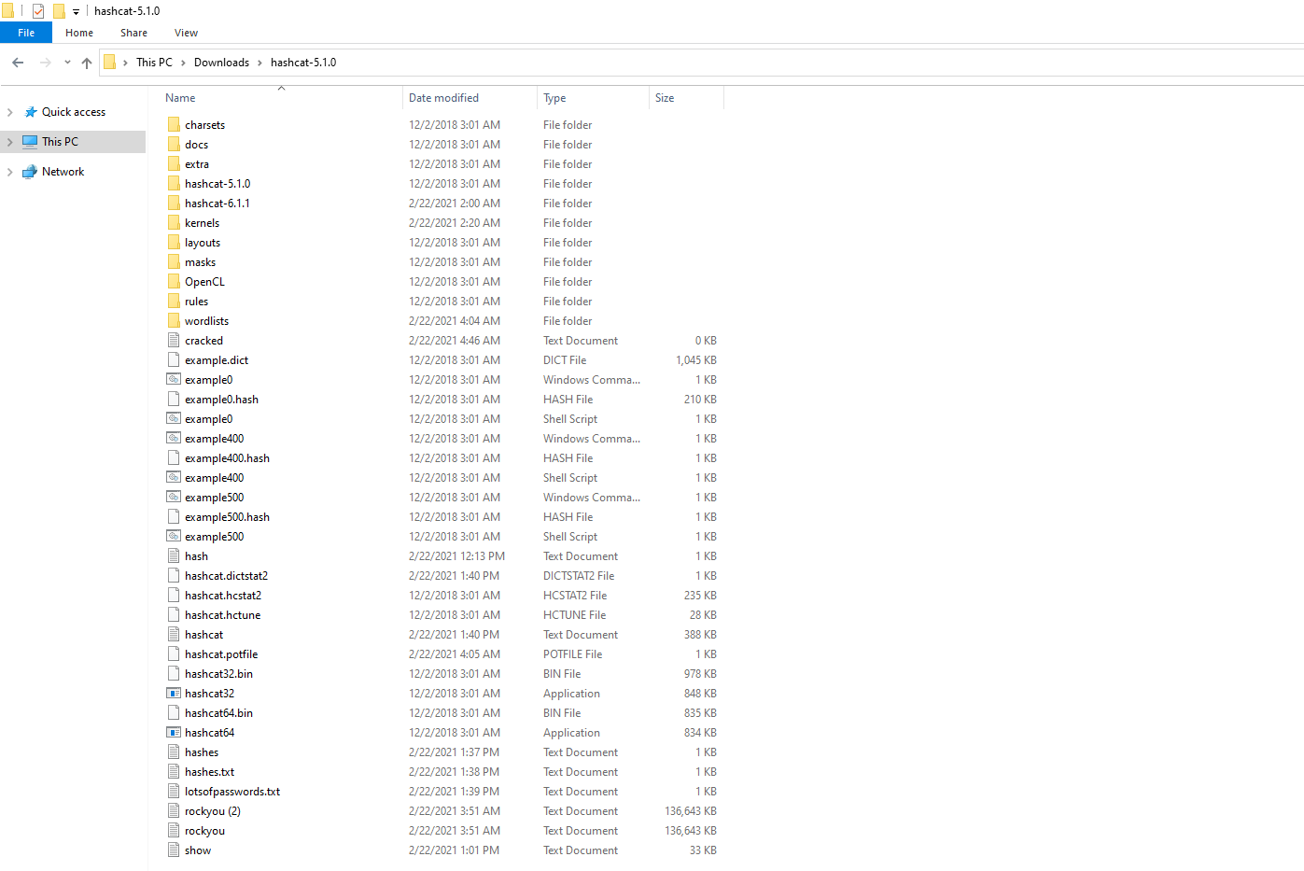

Slide 12
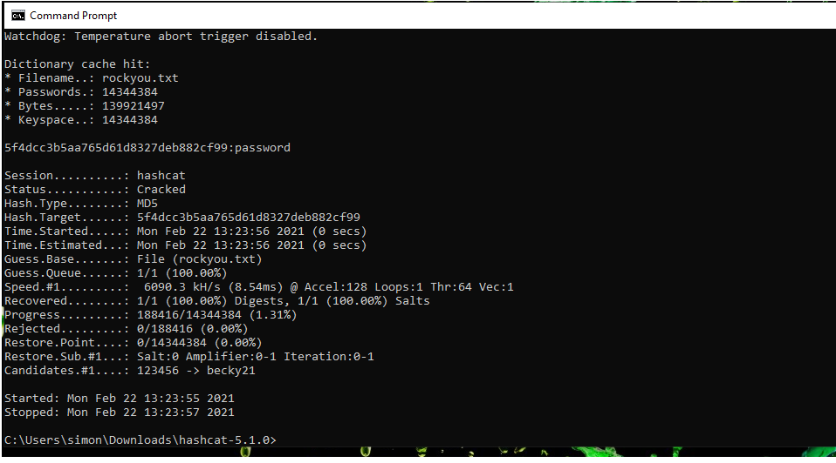

Slide 14
INCIDENT RESPONSE PRELIMINARY ASSESSMENT
Summarize ongoing incident:
What do you know so far?
I know that cybercriminals are holding the hospital hostage because they are holding the hospitals personal files and folders hostage by using ransomeware. The Cybercriminals expect them to pay them in bitcoin in exchange they will unlock the personal files and folders.
Document actions or notes from the following steps of the initial incident response checklist
Step 1: I believe that the people that discovered the incident was first it was hospital staff members because they realized that when they tried to login in to the centralized log management system, they realize that they can’t access it and that something was wrong.
Step 2: The indicator of compromise is that the hospital personal files were held hostage, and cybercriminals want bitcoin.
The potential impact of incident is that there was ransomware.
The name of system being targeted is : Fin4Cryptor . The operating system is windows 10 pc. The IP Address is 168.63.129.16
Step 3: A)Yes, the incident is confirmed because the Chief Information security officer informed me that the hospitals were being attack by ransomeware.
B)The incident is still in progress, and it hasn’t been resolved yet.
C) yes, the incident is urgent
D) No response will alert the attacker because I can’t seem to find any information about who the attackers were or how to track where the attacker is located .
E) The type of incident is a virus because someone in the hospital opened an email attachment that contained a virus.
Step 4: No, there are no human life at risk.
Step 6: I would consider the category as Category two- A threat to sensitive data.
(Add another slide if needed)

Slide 15
INCIDENT RESPONSE RECOMMENDED ACTION
Summarize recommendation to contain, eradicate, and recover:
Describe the overall recommended containment, eradication, and recovery plan
I would recommend that everyone should be informed not to open email attachments from people that they don’t know. Because if you open an email attachment containing virus, it can harm your company or computer.
Documented actions and notes from the IR checklist
Step 7: (Tip: Select procedures you’d recommend for this type of incident)
I would recommend that that there should be a virus response procedure. Because if the hospital employee didn’t open a email with virus attachment in it, then there wouldn’t be any ransomeware.
I would also recommend insider threat procedure because you want to train employees within the company to not be an insider threat.
Step 8: Yes, I believe that it is possible to review systems logs, check computer activity, and interview witnesses to determine how the incident was caused. If you do this procedure, then it would make it more safe, and prevent the incident from happening again.
Step 9: I would recommend that the changes that the IR team should make is all of the above actions listed. Because if you follow those actions, then it makes it safer.
Step 10: A)The incident was discovered by hospital staff because they found out the they couldn’t access to the hospital personal files. They learned that an employee in the hospital opened an email attachment that contain a virus and ransomware.
B)The category of the incident is: a threat to sensitive data .
C) The incident occurred through email because an hospital employee opened an email attachment that contained virus and ransomware.
D) It doesn’t really tell where the attack came from or who is the attacker in this case.
E) The response plan is try to log into the computer, and to try to track information about the cybercriminals and who they are.
F) What was done in response is to find evidence about who was the threat. I wanted to know who was the outside threat which in this case is the cybercriminals. I also wanted to find out the insider threat .

Slide 16
10 G) yes, the response is effective.
Step 12:A) Yes, I believe that another procedure could prevent intrusions because if add more procedures it will make it more safe.
B) Yes, the incidence response is appropriate.
C)Yes, the incident response is detailed and it covered the situation.
D)The changes that can be made to prevent re-infection is to add virus protection to the computer.
E) I have learned a lot about cybersecurity. I have learned about external threats and internal threats.
(Add another slide if needed)

